Slide 1
The Psychology Of Resigning
Why are your people leaving your organization?

Slide 2
The Psychology Of Resigning
“Between stimulus and response there is a space.
In that space is our power to choose our response. In our response lies our growth and our freedom.”
– Viktor Frankl
Stimuli trigger emotional consequences through beliefs. This means that an event goes through a process where it is dissected via a preset system of rarely challenged beliefs that engender an emotional response that may include feelings. This belief system is made of biases, cognitive distortions, irrational beliefs which are often negative and limited.

Slide 3

The Psychology Of Resigning
Thus, a single event, a specific circumstance, a singular situation can provide a distorted or altered reality.
As such, employees’ feelings or opinions, and perspectives may not be rational, accurate, or proportional to the event.
Nonetheless, it is the perceived reality and to the individual it is fact, truth, and genuine.

Slide 4
The Psychology Of Resigning
But what is decision making?
It is ‘the output of a series of cognitive processes, through which a number of variables are balanced and evaluated, leading to an outcome that may result in an action or an opinion’ (Warren, 2010).
“Human decision making is often studied as the outcome of a careful evaluation of alternative options in terms of the likelihood and the value of outcomes associated with these options.” J. Van Der Plight, 2001

Slide 5
The Psychology Of Resigning
Decision making is crucial because it shapes our reality. It triggers either positive or negative emotions and feelings that will ultimately decide whether we are happy or not, and ultimately if we should stay or leave an employer.
Humans constantly evaluate options. From ‘what should we eat for dinner’ to ‘what can I do to make my office a better work environment’. To us, it appears as an easy process whereas pros and cons on long-term and short-term eventualities are carefully considered. It might even seem based on fact, logic and wisdom.
But is it really?

Slide 6
The Psychology Of Resigning
“We often like to think that we’re like Mr. Spock in Star Trek, and very rational and logical. But we’re not. And, if you want to really reach people, if you want to communicate with them, if you want to persuade them, you need to figure out how to talk to the unconscious part of their mind.”
-Susan Weinschenk
The evaluation of options triggers two separate brain regions activating either our conscious or unconscious.
It turns out, 90% of our decision making is processed by our unconscious.

Slide 7
The Psychology Of Resigning
How does it work?
The unconscious system functions rapidly, naturally, and without any awareness of voluntary control. It is fast, associative, intuitive, and automatic.
The conscious system, on the other hand, devotes attention to the demanding mental operations that requires it. It is slow, effortful, logical, lazy, and indecisive.

Slide 8
The Psychology Of Resigning
This is why the unconscious has been made the primary function in decision making.
So, the unconscious processes the information, comes up with a solution that is then passed on to the conscious making us feel that we were in charge and practical this whole time.
The problem is, the unconscious is irrational and bases its process on the legitimacy of underlying assumptions, full of cognitive distortions, biased and irrational beliefs.

Slide 9
The Psychology Of Resigning
Take a look at some of the cognitive distortions used in decision making:
Polarized thinking: all or nothing thinking pattern
Mental filtering: either focusing on negative and filtering positive out or refusing to acknowledge positives altogether.
Overgeneralization: focusing on one event and incorrectly concluding all similar events going forward will result in the same negative experience
Jumping to conclusions: mind reading, fortune telling
Catastrophizing: magnification leading to worst-case scenario or minimization leading to diminishing positive experiences
Personalization: taking thinks personally
Blaming: victim role, holding other responsible for their pain, not taking responsibilities.
Labeling: Assigning judgement to oneself or others based on one negative incident
Always being right: will go to great length to prove they are right
Should statements: Should, must, shouldn’t do rules enforced on themselves and others
Emotional reasoning: emotion is accepted as fact because all logical reasoning is blocked out.
Control fallacies: either external translating in fatalism, or external leading to self-blame
Fallacy of change: pressuring others to change because they are convinced their happiness is dependent on the person changing
Fallacy of fairness: all things should be fair to them
Heaven’s reward fallacy: rewarded on how hard you work, loyalty

Slide 10
The Psychology Of Resigning
While the irrational unconscious is going through its list of cognitive distortions, biased and irrational beliefs, the rational conscious mind isn’t even awake yet.
This translates into choices that can be regarded as illogical, irrational, or outright incomprehensible for any leader to grasp.
This is why an employer might look at their work environment and believe it to be absolutely healthy, while employees see it as a toxic environment.

Slide 11
The Psychology Of Resigning
The solution?
Connect, ask, and communicate on a permanent basis. Since you cannot manage what you don’t know, acquiring well-being intel is paramount.
Don’t forget that it is never about what you think or feel, but what your employees are experiencing that will be the ultimate factor on your turnover ration.
“If you don’t appreciate your employees, your competitor will. They’re looking for great talent.
Do It Now! Sometimes ’Later’ Becomes ‘Never’.”

Slide 12
We can help
In terms of human capital management, Progressive Human Development Services has developed a unique and ground-breaking methodology to manage:
Employee retention
New talent attraction
Productivity boost
Our methodology is academic and science-based for outstanding and fast results. It is completely tailored to your needs and wants and can include:
Diagnosing strength and weakness
Needs assessment
Baseline survey
Strategy assessment and implementation
Call me now and let’s continue the conversation. 1 236 992 2340 (Its just a talk…)

Slide 13
What’s next?
What is keeping you up at night as a professional?
Progressive Human Development Services specialize in restoring good night sleep, free of business worries. We offer a variety of avenue to address your concerns based on your needs and strengths.
Let’s continue the conversation: call me now at 236 992 2340 or message me on LinkedIn for a free chat.
Progressive Human Development Services won’t just ”fix” your business concerns, it will empower and support you to do so.
Call me know.

Slide 14
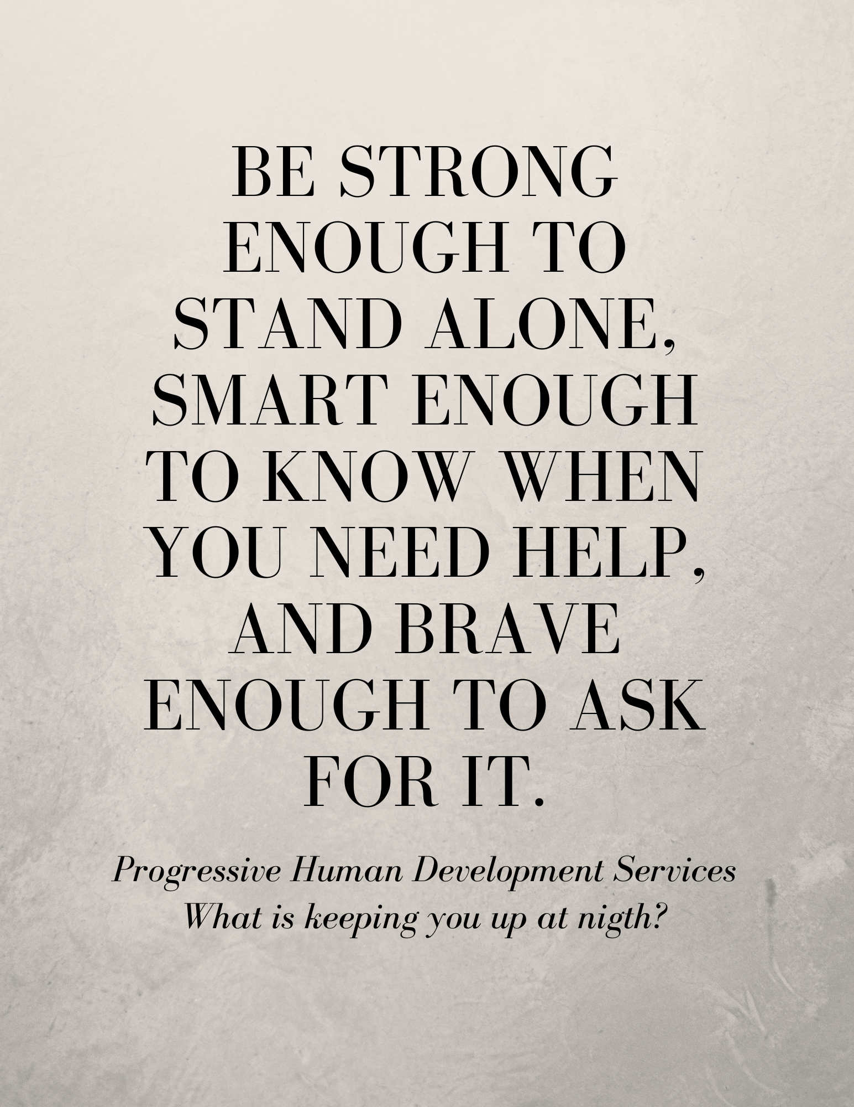
Thank you!
Progressive Human Development Services
What is keeping you up at night?
Have questions? Want to continue the conversation?
Contact us, we are ready to talk.
Don’t miss it: Check out all the resources available to you from Progressive Human Development Services
1 236 992 2340
Progressive123.com
davidwanner@progressive123.com

