Slide 1
6 Strategies
To Manage Turnover
Your labor shortage survival guide

Slide 2
Welcome To The Resistance
“I have never seen as bad…”
“We have explored all avenues unsuccessfully…”
“This is creating such uncertainty and fear for the future of our organization”…
– Leaders around the globe
This is what can be heard almost everyday from leaders who are desperately trying to seek solutions to a worldwide problem of unprecedented proportions. Human capital management is the biggest and most talked about issue in business today, and for good reason.
“If you don’t appreciate your employees, your competitor will. They’re looking for great talent.
Do It Now! Sometimes ’Later’ Becomes ‘Never’.”

Slide 3
The State Of The Union:
Right now, more people are leaving the job market than entering it. Blame it on the retiring baby-boomers, the decade long dwindling birth rates, the pandemic, the immigration interruption, inflation, recession, wage stagnation, the rise of solopreneurs - it doesn’t matter - the bottom line is, we have a serious labor shortage.
This translates into an employee’s market. Workers have leverage, choices, and they know it. Since leaders have worked diligently to (not so gently) squeeze loyalty out of their employees by tattooing them with the “It’s not personal, it’s only business!” moto, the work force is happy to oblige by it now. Karma is a wonderful thing.

Slide 4
Times Have Changed
“The difference between a strong man and a weak one is that the former does not give up after defeat.”
– Woodrow Wilson
The fact is, times have changed. It is not business as usual, and it is time to adapt or die. It is a slow death mind you, a bit of the frog in hot water story, and that makes it the more dangerous.
We can’t control the labor market, but we can control employee turnover while becoming more attractive to new candidates.

Slide 5
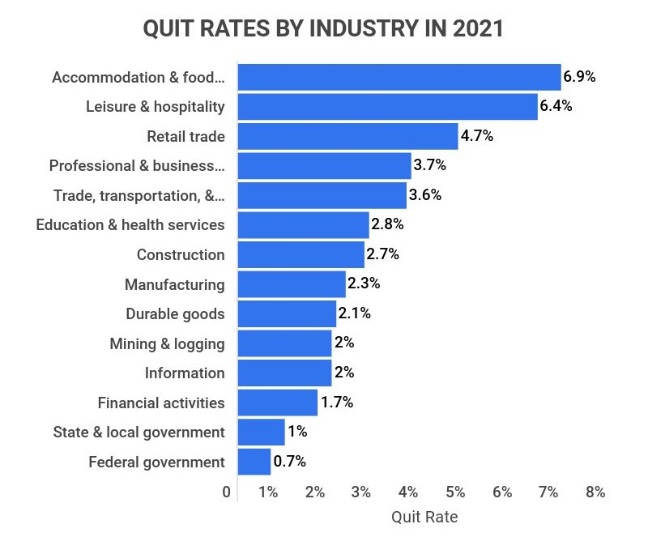
By The Numbers
It is estimated that of more than 3 billion workers worldwide, only 40% are happy in their current position. That leaves a staggering 2 billion unhappy employees.
Over 38 million American voluntarily quit their jobs in 2021
4.2 million American workers resigned in June 2022 alone
40% of American and 38% of Canadian employees want to quit their jobs in 2022

Slide 6
Why Are They Resigning?
Top 4 reasons for quitting
Unhealthy/undesirable culture, toxic company culture (62%)
1
#1 – 62%
Insufficient pay or unfair pay practices, low salary (59%)
2
#2 – 59%
Lack of trust in leaders, uncaring/uninspiring leaders, poor management (56%)
#3 – 56%
3
Lack of healthy work-life boundaries (49%)
#4 – 49%
4

Slide 7
What is the problem?
The problem is simple: workers are unhappy.
This is not difficult to comprehend since their values are no longer aligned with their employer’s values. Should basic needs not be fulfilled, human-kind cannot thrive and well-being is affected. The result: unhappiness.
Give them no (?) opportunity, and leaving becomes the best and most logical option.
So, what can be done to turn the tables?

Slide 8
The 6 Strategies to Manage Turnover
#1
Track and monitor
#2
Set your values
#3
Establish psychological safety
#4
Be a true leader
#5
Recruit the right talent
#6
Provide basic psychological work needs

Slide 9
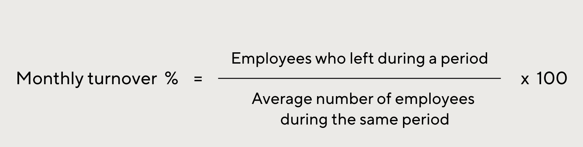
1 – Track and monitor
You can’t manage what you don’t see: to understand the scope of your business situation, you must first monitor and track turnover. No need for fanciness, a simple spreadsheet will suffice.
You will need to track:
Time period tracked (week, month, quarter, year, etc.)
Opening workforce balance (total number of employees at the beginning of the period)
Number of new employees joining during the period
Number of employees lost during the period
Closing workforce balance
Turnover
You can use the magic formula below to calculate your turnover (#6)
Tips:
It might be wise to have a tracking system for the entire company, and another one for the different departments in order to provide you with more data.
Be sure to conduct intelligent (validated) and (well researched) productive surveys within the company and departments based on wellness, happiness, engagement and other holistic study tools.

Slide 10
2 – Set Your Values
A powerful business has a definite vision, values, standards, ethics, and morals.
If you know who you are, what you do, and how you do it, what you will or will not allow, your strengths and weakness, what you exemplify and represent - as a leader and a company - you will attract like-minded individuals who not only will align with your objective (?), but will fight for and defend them vigorously.
With strong and definite values, you will provide clear communication and have a reference to make rational and decisive decisions your people will understand.
“When standards are set, decisions are easy”

Slide 11
3 – Foster Psychological Safety
Psychological safety is the foundation of a positive and healthy work environment.
It is the belief and feeling that no harm will come to you by engaging in the workplace. An absence of interpersonal fear.
No punishment, embarrassment, rejection, retribution, humiliation, or shame for speaking up with ideas, questions, concerns, or mistakes, but encouragement, rewards, and recognition.
Tip:
Psychological safety supports the creation of a respectful, healthy, engaging, and learning environment.
It acknowledges psychological risk factors where they exist and provides the tools to positively, effectively and efficiently address any identified issues.

Slide 12
4 – Be The Leader They Deserve
Exceptional leaders understand the importance of knowing, loving and inspiring their people. As a result, trust is established while communication is fluid and organic.
This means:
Know your people:
Powerful leaders know their team’s values and strengths through active listening, powerful questioning and empathy. Knowledge is power!
Love your people:
Effective leaders love their team through compassion, service and creating psychological safety.
Inspire your people:
Great leaders inspire their team through a clear sense of purpose, optimism and gratitude.

Slide 13
5 – Recruit The Right Talent
“Better alone than in bad company” is what my Dad always told me.
Hiring the wrong individuals will cost you dearly and contribute to the toxic environment. So, who should you hire? Only individuals who are in line with your vision, values, standards, ethics, and morals.
Tip:
Skills can be taught, but values cannot. Spend all your time understanding the strengths and values of applicants before hiring them. And no matter how much you need new blood, don’t hire unless they fit within your organization. Quick fixes are costly and leave a nasty mark.

Slide 14
6 – Provide Basic Psychological Needs
Just like a fire needs 3 essential and necessary ingredients to exist, humans also require 3 universal basic needs to thrive and flourish in the workplace.
Take one out, and the whole system collapses and ceases to function. They are intertwined, integral, elemental and intrinsic, providing each element with a remarkable synergy.
Autonomy
Relatedness
Oxygen
Ignition
Fuel
Competency
Basic Employee Needs Triangle

Slide 15
6 – Provide Basic Psychological Needs: Autonomy
Foster Autonomy
Autonomy is the ability to feel in control of our own behaviors and goals, independent and able to act in a way that matches our desires. If employees lack autonomy, they feel controlled by forces that are not aligned with who they are, whether internal or external. People who are controlled and not autonomous will suffer unhealthy outcomes. Autonomy results in employee engagement, with significant gains in ownership, responsibility, self-esteem, pride, independence, creativity, passion, and overall productivity.
Tip:
Establish a trusting environment, promote self-management, personalize the work environment, inclusivity and involvement of employees in your business, provide a strong “WHY”, set clear goals and objectives, recommend rewards and incentives, offer context in organizational direction and changes.

Slide 16
6 – Provide Basic Psychological Needs: Relatedness
Encourage relatedness
Relatedness, also called meaningful connections, is the ability to feel connected with others and a sense of belonging. In order to have one’s relatedness needs met, they must feel important to the other individuals in their circle. When an individual feels their thoughts, emotions, actions and goals are valued and respected, and when they feel connected with others, emotional trigger sensitivity is reduced. It promotes enhanced motivation, vitality, positivity, morale, satisfaction, self-esteem, leadership, teamwork, and performance while reducing conflict.
Tip:
Provide an inclusive-equal-just-fair-impartial environment, build high quality connections, foster respectful engagements, identify-understand-promote-share your employees strengths, promote communication-teamwork-relationship-collaboration, establish rapport and trust, address problem as they occur swiftly and decisively.

Slide 17
6 – Provide Basic Psychological Needs: Competency
Provide competency
Competency is the ability and experience of mastery. It is to feel effective in what one does with adequate qualities, intellect, judgement, strength, knowledge, skill, and awareness to achieve and surpass goals. When an individuals feel competent, they feel a sense of mastery over their environment and feel confident in their capabilities. When people feel that they have the skills needed for success, they are more likely to take action that will help them achieve their goals. This promotes self-esteem, confidence, goal making, self-development, achievement, positivity, respect, bravery, success, and performance.
Tip:
Provide outstanding and continuous training, have a competent and enthusiastic support system, match the right people with the right tasks and responsibilities, help set realistic and obtainable goals, inspire self-improvement/self-awareness/self-examination/self-regulation, provide authentic and positive feedback often, remove repetition and promote change, advocate self physical and psychological care.

Slide 18
We can help
In terms of human capital management, Progressive Human Development Services has developed a unique and ground-breaking methodology to manage:
Employee retention
New talent attraction
Productivity boost
Our methodology is academic and science-based for outstanding and fast results. It is completely tailored to your needs and wants and can include:
Diagnosing strength and weakness
Needs assessment
Baseline survey
Strategy assessment and implementation
Call me now and let’s continue the conversation. 1 236 992 2340 (Its just a talk…)

Slide 19
What’s next?
What is keeping you up at night as a professional?
Progressive Human Development Services specialize in restoring good night sleep, free of business worries. We offer a variety of avenue to address your concerns based on your needs and strengths.
Let’s continue the conversation: call me now at 236 992 2340 or message me on LinkedIn for a free chat.
Progressive Human Development Services won’t just ”fix” your business concerns, it will empower and support you to do so.
Call me know.

Slide 20
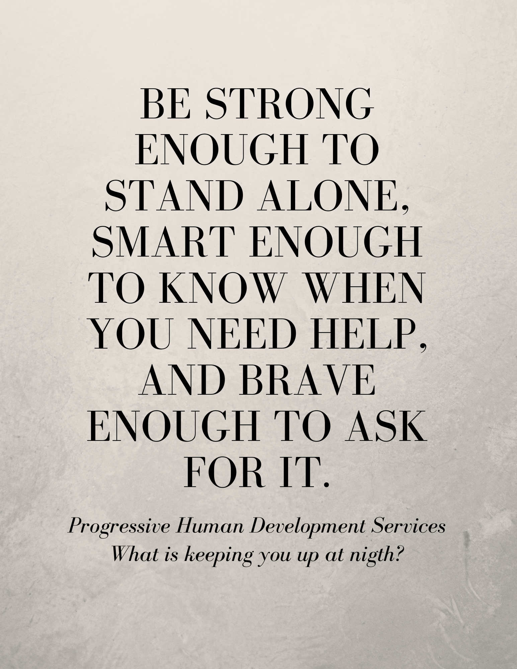
Thank you!
Progressive Human Development Services
What is keeping you up at night?
Have questions? Want to continue the conversation?
Contact us, we are ready to talk.
Don’t miss it: Check out all the resources available to you from Progressive Human Development Services
1 236 992 2340
Progressive123.com
davidwanner@progressive123.com

