Slide 1
The 6 reasons to address turnover today
What’s in it for you?

Slide 2
The 6 reasons…
Turnover is one of the most talked about subject in business today.
Why is it so important, and what’s in it for you?
Stop bleeding money
Reclaim your time
Get healthier team dynamics and eliminate the vicious circle
Superior overall business performance and productivity
Restore connections and relationships
Enhance morale and well-being
Follow me…
“If you don’t appreciate your employees, your competitor will. They’re looking for great talent.
Do It Now! Sometimes ’Later’ Becomes ‘Never’.”

Slide 3
Stop bleeding money:
Employee turnover has a significant and direct impact on the bottom line. A study by SHRM finds that replacing a salaried employee typically costs 60 to 90 percent of that person’s annual salary, while other studies mention 90% to 200%. According to the "Organization Science" magazine, the estimated cost of a lost employee earning $8 per hour at a retail chain store is $3,500 to $25,000.
You be the judge: an employee with a salary of $50k will cost you about $75k after benefits, vacation pay, and all other state-province/federal requirements. Additionally, a company could pay 1/3 of the yearly salary of the new employee in onboarding costs. That’s another $15,000. Factor in your time and that of others such as supervisors, managers, trainers, coworkers, HR staff, etc. Additionally, the new employee may take several months to fully learn the job and achieve competency in the position. Now add legal fees, and It all translates into wasted money without headway.
Losing a top talent has even more dire consequences: Profitability, customer satisfaction, loss of valuable knowledge, gain by the competition should they jump ship, lower productivity of the departing employee. You can’t afford to lose your people.

Slide 4
Reclaim your time:
The amount of time lost due to turnover is astronomical. Look at all the parties involved in hiring, training, managing, and exiting your people. From recruiting interviews to exit interviews, countless of individual precious time is wasted. To add insult to injury, supervisors, managers, and colleagues are often left to take on the work left by a quitter and cover until a new employee is hired and able to perform, which might take longer than desired.

Slide 5
Get healthier team dynamics and eliminate the vicious circle:
Staff turnover creates its own team dynamic issue, adding to the original turnover reasons. The more people leave, the less positive dynamics can survive. Broken up teams take time to readjust while the remaining staff is left in limbo. It soon starts compounding resulting in an uncontrollable vicious circle where moral is crushed.

Slide 6
Superior Overall business performance and productivity:
A high turnover environment affects employee well-being, directly impacting businesses performance and productivity by up to 15%. But, the obvious loss of manpower is only the tip of the iceberg. Despite their well intentions, new additions, by definition, are less efficient and need more time to complete tasks at inferior quality levels than established staff. They might also require the help of colleagues which will have to stop their own work to assist, losing their momentum.
Errors, omissions, mistakes will all affect performance. Remaining staff must absorb responsibilities and tasks of the vacant position affecting their regular performance. The negative and depressed environment induces burnout, stress, overall discontentment, disconnect, focus on negatives instead of the tasks at hand, and short and long term sick leaves. As a result, companies with lower retention rates and high turnover are often less competitive and produce less than companies with a stable workforce.

Slide 7
Restore connections and relationships:
High turnover rate affects the continuity of service to clients and other employees. This is certainly true in the service industry which relies heavily on relationships with clients, but rest assured, all industries are affected. Clients want and need consistency to establish strong connections and relationships while many migth be irritated to have to deal with a new person contently. Furthermore, an experienced employee who offers a familiar face to your business and who knows and understands the client’s needs, wants, preferences, and history will be replaced, leaving a palpable void. Unfortunately, turnover is a killer in that department as it will destroy your customer’s loyalty. Your clients will smell trouble as they experience a toxic environment and a revolving door. This will impact your bottom line in more ways than one as you see your clients leaving you.

Slide 8
Enhance morale and wellbeing:
High turnover affects all employees both physically and mentally. By pulling other workers away from their jobs, accumulating their responsibilities and workload, and increasing their work schedule, stress and burnout will occur. The moral of your troops will dwindle while the uncertainty of their own employment sets in. Complaining, arguing, gossiping, whining, venting, will add insult to injury. All of this, in addition to the initial issues forcing the turnover will affect every employee’s wellbeing.

Slide 9
We can help
In terms of human capital management, Progressive Human Development Services has developed a unique and ground-breaking methodology to manage:
Employee retention
New talent attraction
Productivity boost
Our methodology is academic and science-based for outstanding and fast results. It is completely tailored to your needs and wants and can include:
Diagnosing strength and weakness
Needs assessment
Baseline survey
Strategy assessment and implementation
Call me now and let’s continue the conversation. 1 236 992 2340 (Its just a talk…)

Slide 10
What’s next?
What is keeping you up at night as a professional?
Progressive Human Development Services specialize in restoring good night sleep, free of business worries. We offer a variety of avenue to address your concerns based on your needs and strengths.
Let’s continue the conversation: call me now at 236 992 2340 or message me on LinkedIn for a free chat.
Progressive Human Development Services won’t just ”fix” your business concerns, it will empower and support you to do so.
Call me know.

Slide 11
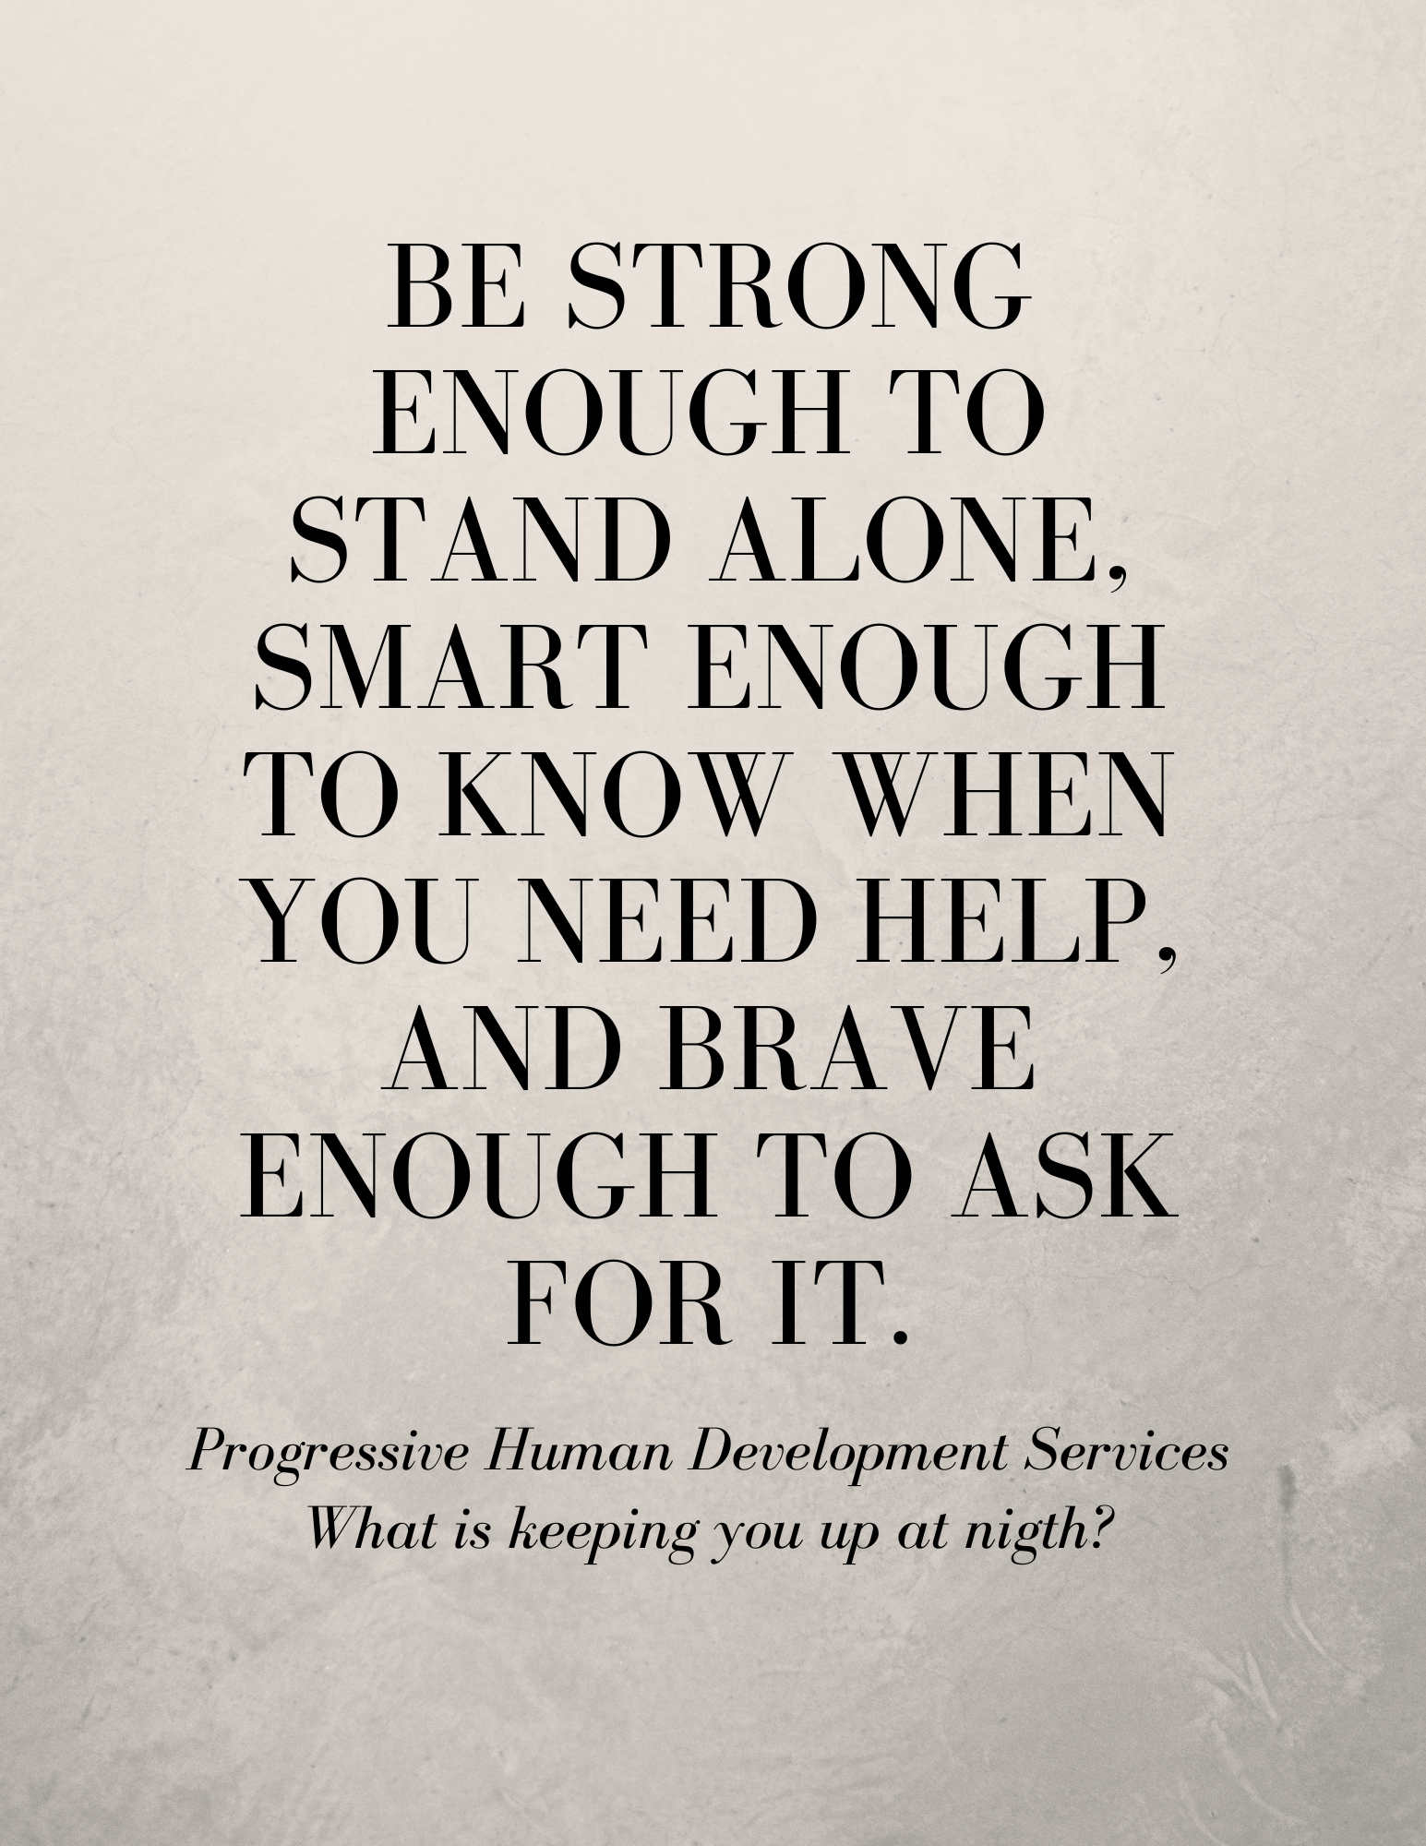
Thank you!
Progressive Human Development Services
What is keeping you up at night?
Have questions? Want to continue the conversation?
Contact us, we are ready to talk.
Don’t miss it: Check out all the resources available to you from Progressive Human Development Services
1 236 992 2340
Progressive123.com
davidwanner@progressive123.com

